Slide 1

Review of
DIT Services

Slide 2
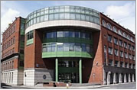
List of services available to DIT students:
Sports and recreation
Apprenticeships
Chaplaincy service
National Optometry Clinic
Disabilities service
Access service
DIT Students Union(DITSU)
Health centre
Societies
DIT Financial Aid + accommodation
Mature Student Support
Library service
International Student support
Maths learning centre
Career services
Counselling service

Slide 3
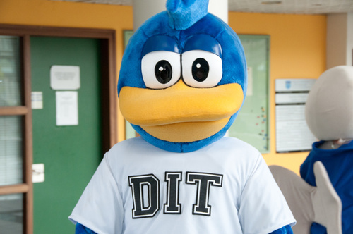
What should you know?
By the end, you should:
Have a overview of all services offered by DIT
Know how to access these services
Appreciate these services
There will be free stuff in this presentation!

Slide 4
Lets Get Started!

Slide 5
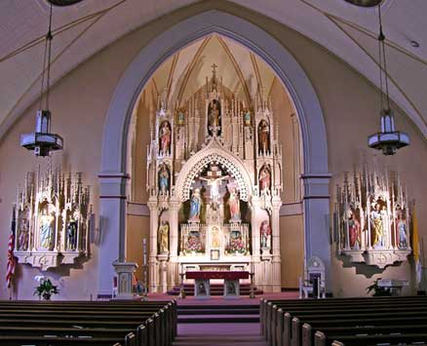
Chaplaincy Service
Mission Statement of Chaplaincy Service:
The men & women of the Chaplaincy Service, from the Christian tradition, empower, support and care for all in the community of the Dublin Institute of Technology, regardless of their belief.
Why should I go to Chaplaincy?

Slide 6

Chaplaincy service is similar to counselling
They will help you with any mental, social or spiritual problem you have
Completely confidential
Help you get help

Slide 7
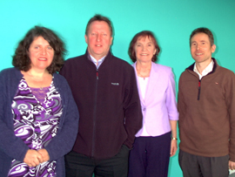
The Chaplains of DIT
From left to right; Fionnuala Walsh (Kevin Street ), Alan Hilliard (Bolton Street), Mary Flanagan (Aungier Street), Finbarr O'Leary (Cathal Brugha Street)

Slide 8

How to access it
Website: www.chaplaincy.dit.ie
Contact chaplains via email
Just call in to the office

Slide 9

Giving Back
The Chaplaincy is also involved in co-ordinating volunteering work
Students can use their free time to volunteer for groups like the Simon Community, Saint Vincent De Paul and various community outreach programs

Slide 10
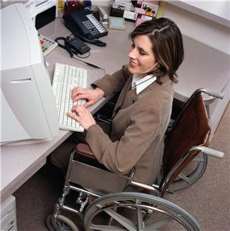

The Disability services function is to support students with disabilities and help them reach their academic goals in DIT
If you suffer from a physical, sensory or learning difficulty you qualify for support
If you believe you are disabled and need support, visit www.accesscollege.ie and www.dit.ie to see details on how to apply for support

Slide 11
What do they actually do?
Services available:
Sign Language interpreting
Electronic note taker
Specialist tuition
Academic/Personal assistant
Photocopying
Specialist equipment

Slide 12
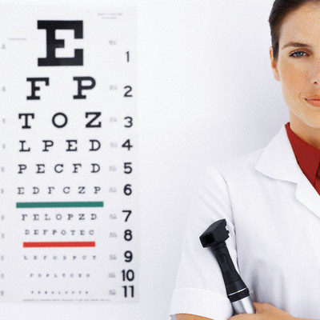
National Optometry Clinic

Slide 13
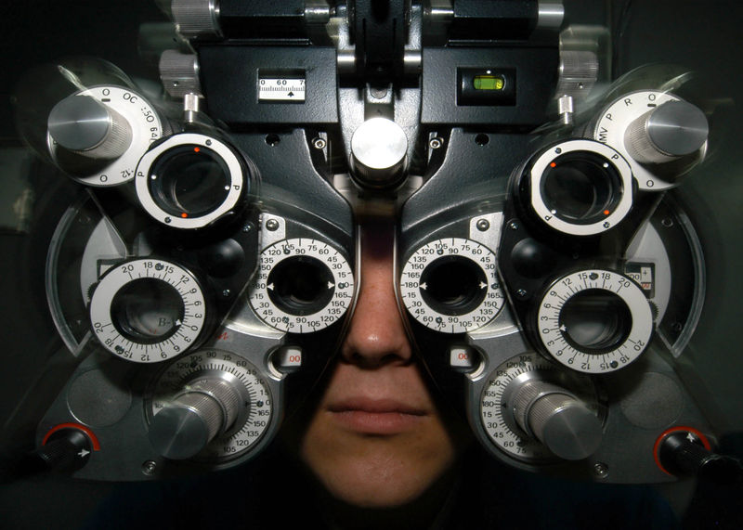
What is it?
It is located in DIT Kevin Street, Faculty of Science
It is a teaching clinic
It is a state of the art centre, the only one of its kind in the country

Slide 14
Why should I care?

Slide 15
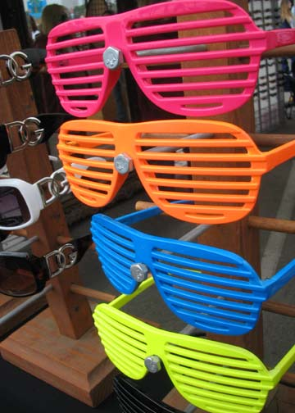

Because free stuff and discounts
Eye examinations and contact lens fittings are free of charge
Discounts on glasses and contact lenses

Slide 16
To make an appointment:
Telephone: 01-402-4900
Email: eyeclinic@dit.ie
Website: www.dit.ie/eyeclinic

Slide 17


Slide 18

Any questions?

